Slide 1

The Cure for Anger and Anxiety
4:1 – 9
Week 39
14 December 2022

Slide 2

Philippians overview chapter four
This fourth and final chapter begins with a series of exhortations to unity, joy, and peace. With great affection, Paul pleads with his beloved Philippians to stand fast in the Lord (1). With great diplomacy and a call for assistance from others, he implores Euodia and Syntyche to be of one mind in the Lord (3-4).
He then follows with a call for them to rejoice always in the Lord, letting their gentleness be known to all, and through prayer and supplication with thanksgiving to allow the peace of God to remove any anxiety (5-7). His final exhortations include a call to meditate on things of virtue and worthy of praise, and to imitate his example in order to ensure that God will be with them (8-9).

Slide 3
Philippians overview chapter four
At last he comes to the matter which occasioned this letter, expressing joy and gratitude for the gift they had sent to him by way of Epaphroditus. As they had done before on several occasions, so now they had provided for his necessities. Paul is thankful, even though he was quite content, for he knows that this gift really abounds to their account, serving as a sweet-smelling sacrifice that is well pleasing to God (10-19).
His closing remarks include praise to God, and greetings from those with him, especially members of Caesar’s household. As was his custom, Paul closes with a final prayer that the grace of the Lord Jesus Christ be with them all (20-23).

Slide 4

The Cure for Anger and Anxiety

Slide 5
Philippians 4:1 – 9
Stand firm in the Lord! With this command Paul begins to wrap up his letter to the Philippians. But what does it look like to “stand firm”? We might picture a righteous man or woman who is “like a tree firmly planted by streams of water” (Ps. 1:3)—fruitful and unshakable, even by the strongest storms.
Or we may imagine a believer clad in the spiritual armor of God, standing firmly against the “schemes of the devil” (Eph. 6:11-13), dodging and deflecting his fiery arrows of temptation.
In Philippians 4, though, Paul unexpectedly applies the notion of “standing firm” in relation to the experiences of anger and anxiety.

Slide 6
Philippians 4:1 – 9
The former causes outward conflict and division, while the latter leads to inward turmoil and despair. It’s hard to imagine two subjects more relevant and practical to deal with than anger and anxiety.
In a world of constant infighting and hand-wringing, anger and anxiety have pervaded even our churches, which should be flagships of both relational harmony and inner peace.
Paul tackles these problems head-on in Philippians 4:1-9, revealing how we can “stand firm in the Lord” against anger and anxiety.

Slide 7
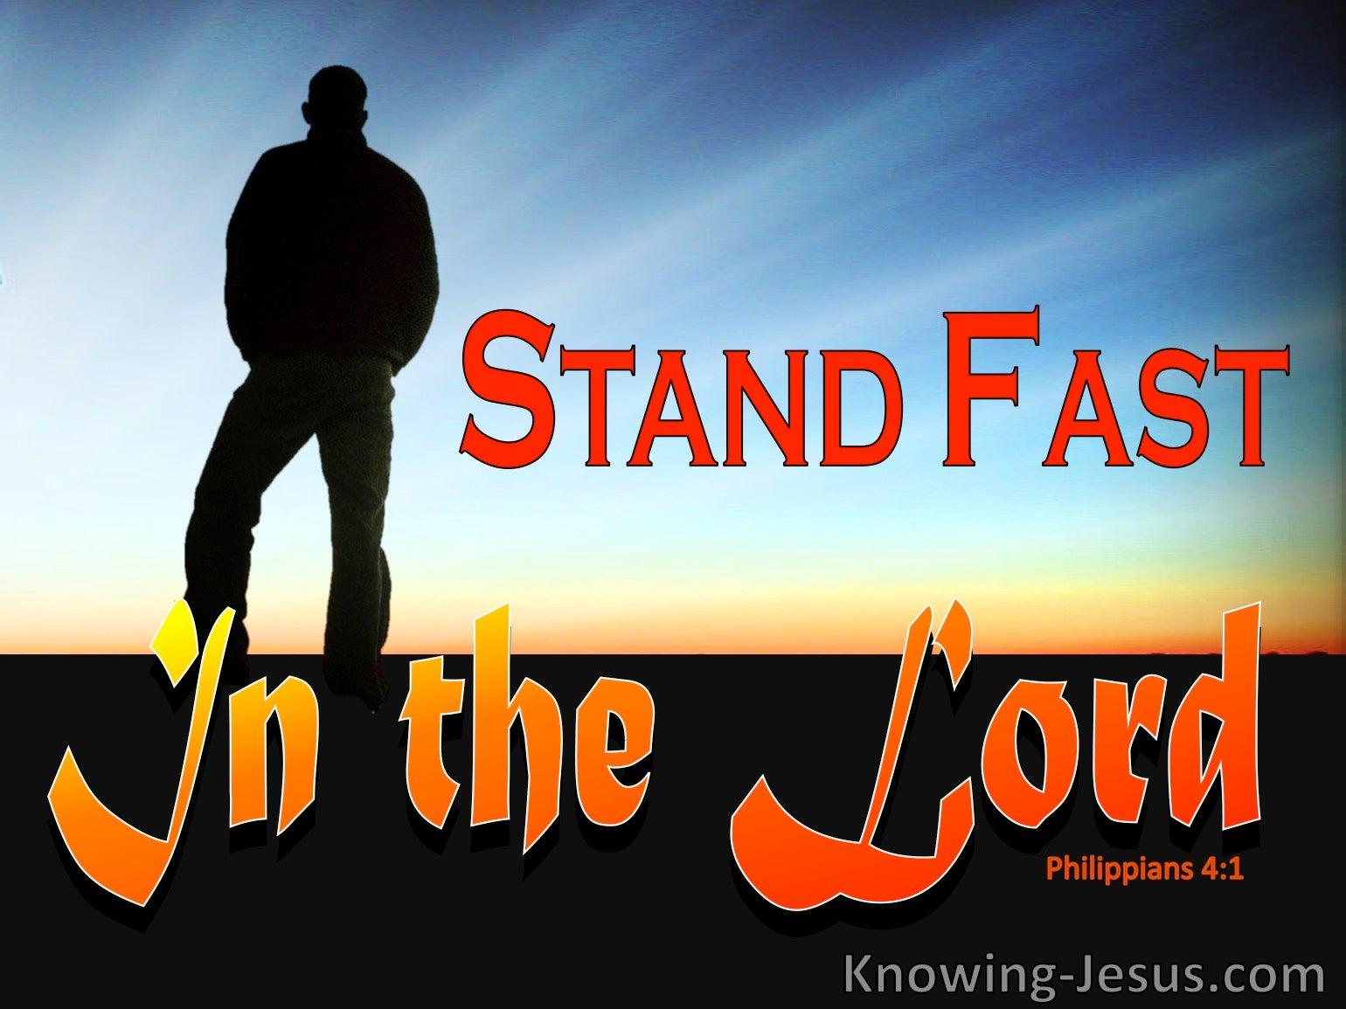

Slide 8
Philippians 4:1 – 3
¹Therefore, my beloved and longed-for brethren, my joy and crown, so stand fast in the Lord, beloved. ²I implore Euodia and I implore Syntyche to be of the same mind in the Lord. ³And I urge you also, true companion, help these women who labored with me in the gospel, with Clement also, and the rest of my fellow workers, whose names are in the Book of Life.

Slide 9
Philippians 4:1 – 3
Standing firm in the Lord precedes relating well in the family of God. This isn’t the first time Paul mentions this crucial principle. In 1:27 he wrote, “Conduct yourselves in a manner worthy of the gospel of Christ, so that whether I come and see you or remain absent, I will hear of you that you are standing firm in one spirit, with one mind striving together for the faith of the gospel.”
This is a foundational concept for Paul. Standing firm includes following the Lord’s commands, believing His Word, embracing His priorities, loving His people, and following His example. Believers who are committed to standing firm in the Lord have less difficulty when it comes to relating well to fellow believers who are united “in the Lord.”

Slide 10
Philippians 4:1 – 3
Those who stand firm in the Lord have Christ as their unshakable common ground. His big picture and overarching plan become the shared narrative of our lives together—narrow-minded opinions and personal preferences become silly things in light of the unity that comes through standing together in the Lord.
SWINDOLL quotes Harry Ironside > “It is always the effort of Satan to hinder the people of God from steadfastly clinging together, and presenting a united front to the enemy. Alas, that his efforts to introduce dissension so readily succeed because of the flesh in us.”

Slide 11
Philippians 4:1 – 3
In 4:1 Paul says, “So (in this way) stand firm in the Lord” (emphasis added). In what way? Paul probably had in mind what he was about to say to Euodia and Syntyche—two women in the church at Philippi who had an unresolved dispute. By dissolving the dissension, these two women would apply the principle of standing firm in the Lord.
To underscore this, Paul repeats the phrase “in the Lord” in his exhortation to the two women: “Live in harmony in the Lord” (4:2). In other words, they would apply the general principle of standing firm in the Lord (4:1) by living in harmony in the Lord (4:2).

Slide 12
Philippians 4:1 – 3
Though Paul mentions Euodia and Syntyche only briefly, we can still draw a few reasonable conclusions about them based on our observation of these verses.
FIRST, they are both members of the same church in Philippi. We don’t know what their specific relationship is. Perhaps they are sisters, or in-laws, or ministry partners—maybe even a mother and daughter. In any case, they are sisters “in the Lord” and members of the same body of Christ.

Slide 13
Philippians 4:1 – 3
SECOND, they are in the midst of a disagreement that’s causing strife and disunity. Paul urges them both, literally, to “think the same thing” (4:2). He uses the same phrase in Romans 15:5 (“Be of the same mind with one another according to Christ Jesus”) and in 2 Corinthians 13:11 (“Be like-minded, live in peace”).
This doesn’t mean that we cease holding our own opinions about things, but it does mean that we don’t hold our opinion on certain issues over our value for other people. We don’t know what the particular issue was that was causing a dispute between Euodia and Syntyche, but we do know that it cannot have been a major doctrinal dispute like the truth of the Resurrection or the deity of Christ or whether we’re saved by faith.

Slide 14
Philippians 4:1 – 3
When significant doctrinal issues like that arise, Paul tackles them head-on. Here he doesn’t even mention the issue in dispute, suggesting there is no theological correction. However, we do know that these two women have made a pit out of a pothole. They’ve taken a small matter and turned it into a big matter. How do we know that? Because Paul sees a need to call them out by name in a letter written to the whole church. In other words, they have caused a ruckus over something minor, and it is starting to affect the whole church.
THIRD, Paul expects both of them to respond positively to his exhortation. This implies that both are at fault in the dispute and each needs to take steps toward reconciliation.

Slide 15
Philippians 4:1 – 3
Notice the verb Paul uses—and that he uses it twice: “I urge Euodia and I urge Syntyche (4:2). Both are responsible for the conflict and both need to retune their harsh tones to sing again in harmony. Paul obviously knows them well—they have shared in his struggle for the gospel (4:3)—and he seems confident they will respond to his exhortation. He doesn’t rebuke, lecture, threaten, or plead with them. He simply “urges” reconciliation.
FINALLY, Paul calls on others to help in the reconciliation. Yes, Euodia and Syntyche are responsible for humbling themselves and restoring unity. But sometimes a division is so deep and a dispute so long-standing that it requires accountability from someone else, an objective third party who can serve as an arbitrator.

Slide 16
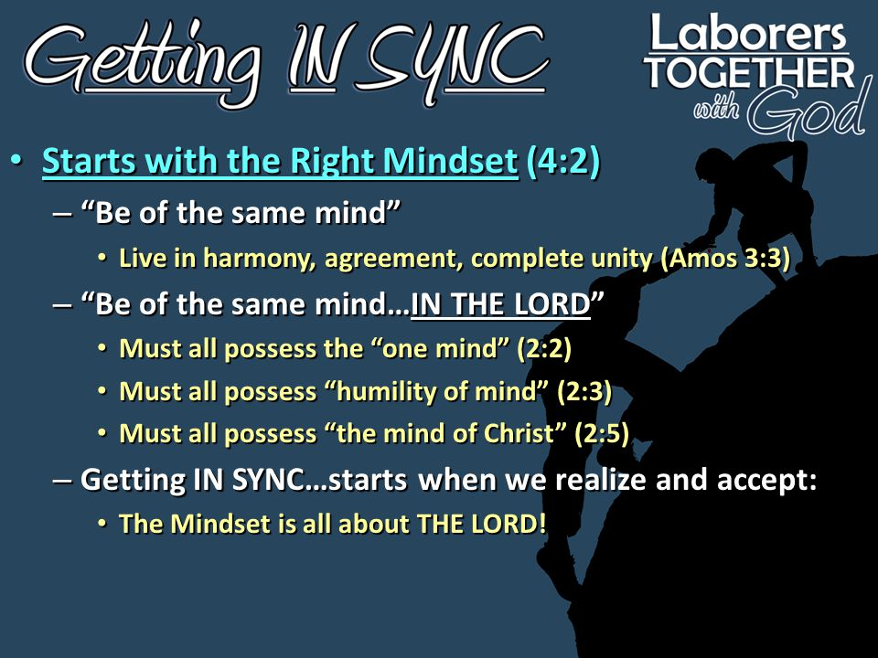

Slide 17
Philippians 4:1 – 3
In this case, Paul requests that his “true companion . . . help these women” (4:3). We don’t know who the “true companion” was. Perhaps it was Timothy or Epaphroditus, or some other authority figure in the church at Philippi. Regardless, this person was well know, well respected, and obviously well qualified to serve as a mediator to help bring about reconciliation.
Having begun this section on a positive note—“I long to see [you], my joy and crown” (4:1)—Paul also ends with an encouraging word. Not only had Euodia and Syntyche shared in Paul’s quest to further the gospel of Jesus Christ, but so had a man named Clement (mentioned only here in the NT), along with many other co-laborers “whose names are in the book of life.”

Slide 18
Philippians 4:1 – 3
Paul no doubt encouraged a speedy reconciliation by reminding the disputing parties that they were one “in the Lord”—with a common hope of eternal life—and were part of a community of co-workers focused on a common goal.

Slide 19
Philippians 4:4 – 7
⁴Rejoice in the Lord always. Again I will say, rejoice!
⁵Let your gentleness be known to all men. The Lord is at hand. ⁶Be anxious for nothing, but in everything by prayer and supplication, with thanksgiving, let your requests be made known to God; ⁷and the peace of God, which surpasses all understanding, will guard your hearts and minds through Christ Jesus.

Slide 20
Philippians 4:4 – 7
In Philippians 4:1-3, we saw how standing firm in the Lord precedes relating well in the family of God. Now, in 4:4-7, Paul explains how standing firm in the Lord relieves our anxiety.
Regrettably, we’ve come to a point in our society when “worry” has become an epidemic, if not an outright plague. Strangely, some seem to treat anxiety like a close friend they don’t want to lose: They excuse it, make room for it, accommodate it, and coddle it. They treat it like a destructive, codependent relationship, and it eats away at their joy day after day. Think about what worry really is and does. When we worry, we’re preoccupied with distressing fears—burdened by the past, nervous about the present, and tormented by the future.

Slide 21
Philippians 4:4 – 7
We live in the realm of “what-ifs.” That kind of mental and emotional agitation can’t be healthy.
No wonder Jesus took worldly worry head-on in His Sermon on the Mount (Matthew 6:25-34). Five times in that famous passage the same Greek term meaning “to worry” appears:
v25 > “Therefore I tell you, do not worry about your life.”
v27 > “Can any one of you by worrying add a single hour to your life?”
v28 > “And why do you worry about clothes?”
v31 > “So do not worry.”
v34 > “Do not worry about tomorrow, for tomorrow will worry about itself.”

Slide 22
Philippians 4:4 – 7
Those who engage in incessant worry find their entire lives off-kilter, teetering on the brink or breakdown. To combat this dangerous trajectory, Paul re-centers our focus in Philippians 4:4 > “Rejoice in the Lord always. Again I will say, rejoice!”
In a letter in which joy has been a constant theme , it’s no surprise that Paul reiterates that theme now, as he is about to discuss the threat of anxiety. By refocusing on the joy we have “in the Lord,” we already begin to pour water on the flames of worry.

Slide 23


Slide 24
Philippians 4:4 – 7
In 4:5, Paul relays two more dimensions of the joyful life in the Lord, both of which can help to combat anxiety.
FIRST – when we let our “gentle spirit” shine through in our words, attitudes, and actions, it will have a transformative effect on our hearts and minds. The idea here is having an easygoing temperament. Instead of worrying about every jot and tittle of our lives—and the lives of others—we need to relax. Let things go. Yield to others. Extend a hand of grace to brothers and sisters in Christ. Let insignificant things slide. Accept differences. This kind of “gentle spirit” will rain on the uncontrolled fires of anxiety.

Slide 25
Philippians 4:4 – 7
SECOND – we need to always bear in mind that “the Lord is near” (4:5). The fact that Christ could step into this world at any moment to take us to be with Him forever can give us hope and peace in every moment. In another letter, Paul described Christ’s coming, in which He would resurrect and rescue believers at His return (1Thes 4:16-17). Paul concludes that passage, “Therefore comfort one another with these words.” Comfort in Christ’s promised return smothers the smoldering anxiety fed by fears of the future.
Another cure for worry is to bring our concerns to God in prayer. Instead of living uptight, tense, uneasy lives, we need to bring everything to God “by prayer and supplication with thanksgiving” (4:6).

Slide 26
Philippians 4:4 – 7
And “everything” means everything. This is key. Worry about nothing: pray about everything. If you feel agitated, pray about it. If you’re scared, lift it to the Lord. If you’re burdened by a past that threatens to come back and haunt you, go to God and ask Him to take it from you. If you can’t get through a minute of the day without stressing about your loved ones, spend that time interceding on their behalf instead of mentally and emotionally running through fruitless “what-if” scenarios.
When you do these things—rejoice in the Lord, exhibit gentleness, expect Christ’s return, and reach out to God in prayer—then God’s Spirit will quench the flames of anxiety in your heart and mind. In 4:7 Paul describes this relief in terms of “the peace of God.”

Slide 27
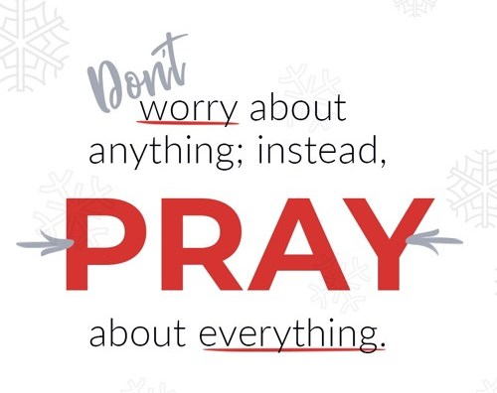

Slide 28
Philippians 4:4 – 7
Paul probably had in mind the Jewish concept of shalom. Theologian Barry Jones brings out the fullness of the concept of shalom in his description: Shalom is often translated in our English Bibles as the word “peace.” But it means much more than our common conceptions of that word convey.
Shalom is more than the absence of hostility or an inner sense of personal well-being. The nuances contained in this single Hebrew word require a cluster of English terms to adequately represent it: wholeness, harmony, flourishing, delight, fulfillment.
Shalom is the dream of God for a world set right.

Slide 29
Philippians 4:4 – 7
No wonder Paul says that God’s peace “surpasses all comprehension: and is able to “guard” our hearts and minds in Christ! This is no mere absence of anxiety, but a positive presence of God’s Spirit of comfort and joy.
This kind of peace doesn’t simply extinguish the flames of anxiety—God’s shalom replaces the dry, parched conditions that ignite worry with the cool, clear, nourishing streams of the river of life!

Slide 30
Philippians 4:8 – 9
⁸Finally, brethren, whatever things are true, whatever things are noble, whatever things are just, whatever things are pure, whatever things are lovely, whatever things are of good report, if there is any virtue and if there is anything praiseworthy—meditate on these things. ⁹The things which you learned and received and heard and saw in me, these do, and the God of peace will be with you.

Slide 31
Philippians 4:8 – 9
Thus far Paul has discussed how standing firm in the Lord (4:1) cures divisive anger (4:2-3) and anxiety (4:4-6). In place of both interpersonal conflicts and inner discontent, God sends His peace (4:7). In 4:8-9, Paul concludes this section with some very simple, practical ways to continue to experience the presence of “the God of peace” (4:9).
FIRST – we need to clean up our thinking by feeding our minds positive thoughts (4:8). Regardless of our difficulties and disappointments, focusing our minds on things of beauty and virtue will quench the flames of anger and anxiety that would otherwise fuel the fire. A change in our patterns of thinking in these areas will result in greater peace with others and deeper peace in our own hearts.

Slide 32
Philippians 4:8 – 9
SECOND – we need to focus our attention on excellent models (4:9). Whenever the Philippians need their faith, love, and hope encouraged, they could look to Paul’s example. He provided a course to follow—one focused on the person and work of Christ and empowered by the Holy Spirit.
Though we don’t have Paul around today, God always places in our lives observable examples who can spur us on to growth and help us experience “the dream of God” as our minds are fixed on Christ.
Anger and anxiety steal our joy and rob us of peace. They force us to focus on the wrong things, drawing us away from a Christlike life.

Slide 33


Slide 34
Philippians 4:8 – 9
When we turn our attention to things that are excellent and worthy of praise (4:8) and follow the godly examples before us (4:9), we will truly know and experience what it means to “stand firm in the Lord” (4:1) and will encounter God’s peace.

Slide 35
Applications
from the
lesson
Fighting for Peace

Slide 36
Philippians Application
Chances are good that you find yourself resonating with one of the roles played in Paul’s discussion of how to stand firm in the Lord. Maybe you can relate to Euodia and Syntyche: You’re in the midst of a longstanding conflict with somebody in the church, at home, at work, or perhaps in your neighborhood.
Or maybe you’re stuck in the awkward position of Paul or the “true companion”—somebody in a position to help others resolve their conflicts.
Perhaps you’re struggling with nagging worry or uncontrollable anxiety, either caused by real sources of stress or by your own obsession over things outside of your control.

Slide 37
Philippians Application
Whatever your present situation—external conflict or internal unrest—Paul gives you some practical principles to begin fighting for peace in your life. Here are three specific things you can begin doing to help you overcome anger and anxiety, enabling you to restore peace in your relationships and in your heart.
FIRST – rejoice. Trade in your old upside-down grin and put a smile back on your face. Teach your heart to rejoice again. Laugh more freely. Live lightheartedly. Cultivate a good sense of humor. Take God seriously and take others seriously, but don’t take yourself so seriously. Proverbs 17:22 says, “A joyful heart is good medicine.”

Slide 38
Philippians Application
Very few joyful people are able to remain in conflict with each other. And rarely do rejoicing and fretting dwell for long in the same heart and mind. So rejoice!
SECOND – relax. We need a healthy dose of gentleness and forbearance. To put it another way, we need to chill out. We don’t have to respond nastily to every nasty comment somebody makes. It’s all right to just let things slide sometimes. We can be easy on people, rather than being hard on them. Relax in your relationships—with your spouse, with your children, with your friends, even with total strangers.

Slide 39
Philippians Application
If Euodia and Syntyche would have just relaxed a little, they probably could have smoothed over their differences. And if we learn to relax, we too can enjoy the peace of God that surpasses all comprehension.
THIRD – rest. This doesn’t mean doing nothing. It means ceasing the mind-racing, heart-pounding, stomach-churning activities that keep us in a constant state of anxiety and edginess. Do you ever notice how dysfunctional our relationships are when we’re stressed out?
Paul’s concept of rest is to fix the heart and mind on positive things. Take a good look at Paul’s sampling of things worth dwelling on in Philippians 4:8, and consider their alternatives: whatever is . . .

Slide 40
Philippians Application
true … not false, untrustworthy, or imagined
noble … not shameful, twisted, or foolish
just … not wrong, sinful, or rebellious
pure … not tainted, coarse, or immoral
lovely … not distorted, ugly, or offensive
good report … not gossipy, slanderous, or sarcastic
virtue … not inferior, wasteful, or flawed
praiseworthy … not objectionable, insulting, or evil

Slide 41
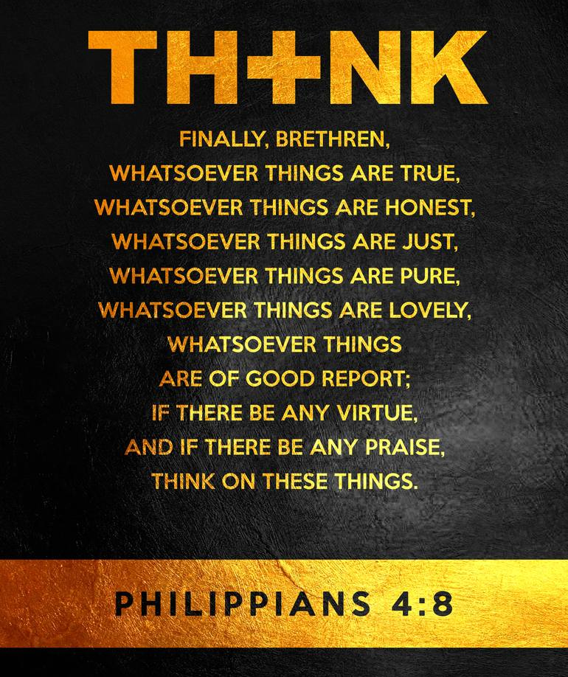

Slide 42
Philippians Application
Rejoice. Relax. Rest. When these principles become practices, and the practices become patterns, then “the peace of God, which surpasses all comprehension, will guard your hearts and your minds in Christ Jesus” (4:7).
God’s dream will become your reality.

Slide 43



Slide 44
NEXT CLASS – 11 January 2023
Book of Philippians
Before next class, read the below verses in the NKJV and in one other versions of the Bible, i.e., NIV, NRSV, KJV, CEV, etc …
Chapter 4:10 – 23
“Living Beyond Our Needs”

